Slide 1

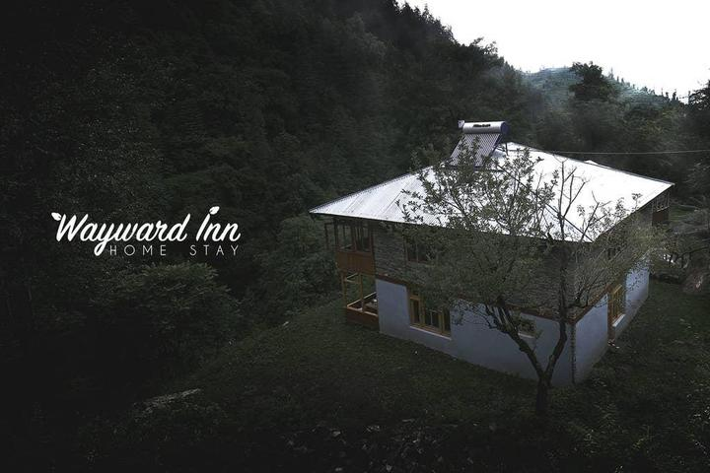

Host Behaviour Analysis For Property Rental Company

Slide 2
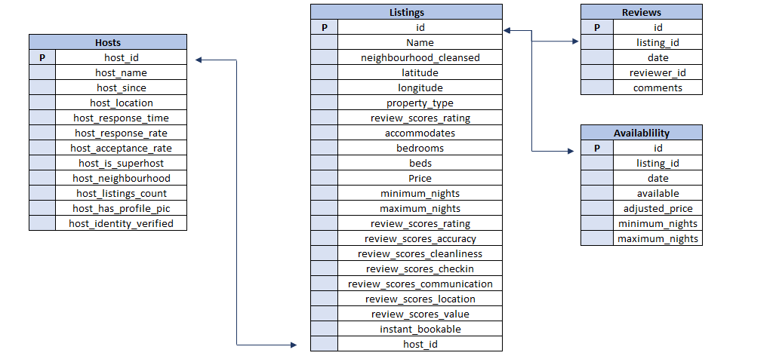
DATA OVERVIEW

Slide 3






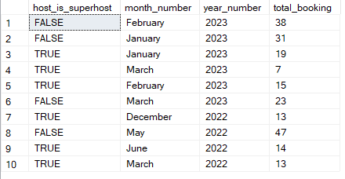
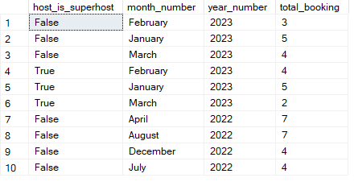
Different metrics to give the insight between Super Host and Other Hosts on instant booking, identity verified and average number of bookings
True = Super host
False = Host
TORONTO
VANCOUVER

Slide 4
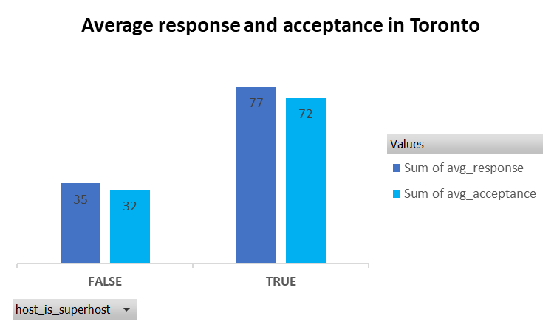
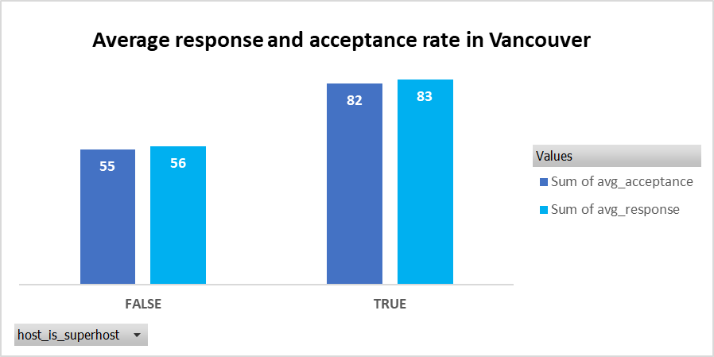
Top 3 crucial metrics one needs to maintain to become a Super Host
True = Super host
False = Host
TORONTO
VANCOUVER
If avg_response is more than 77, than the probability to become superhost is higher
If avg_acceptance is more than 72, than the probability to become superhost is higher
If avg_response is more than 83, than the probability to become superhost is higher
If avg_acceptance is more than 82, than the probability to become superhost is higher

Slide 5
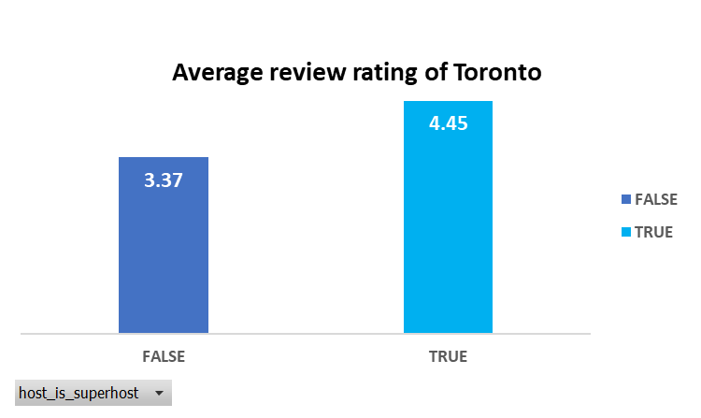
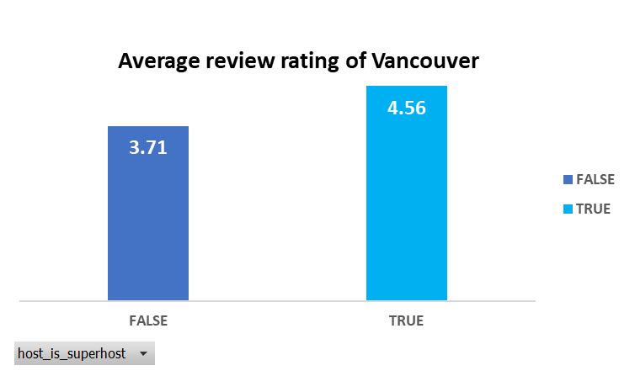
TORONTO
VANCOUVER
If avg_rating is more than 4.45, than the probability to become superhost is higher
If avg_rating is less than 3.37, than the probability to become superhost is very less
If avg_rating is more than 4.56, than the probability to become superhost is higher
If avg_rating is less than 3.71, than the probability to become superhost is very less

Slide 6
Common Insight
In both the cities , if avg_response is more than 80, avg_acceptance is more than 75 and rating is more than 4.5 , than their are huge chances that host can become a superhost
avg_acceptance of superhost in Vancouver is 10% more than that of Toronto
avg_response of superhost in Vancouver is 5% more than that of Toronto
avg_acceptance of host in Vancouver is 23% more than that of Toronto
avg_response of host in Vancouver is 21% more than that of Toronto
These insights plays a vital role for any HOST to become a SUPERHOST

Slide 7
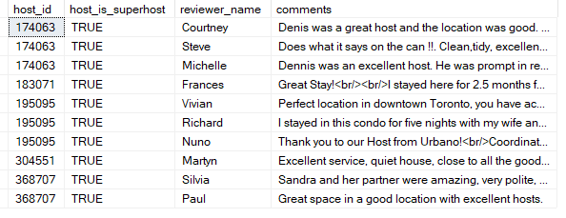
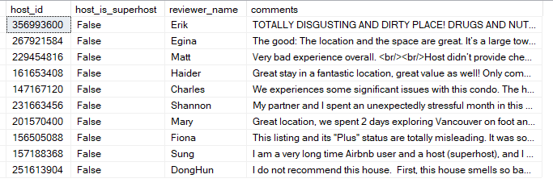
comments of reviewers vary for listings of Super Hosts vs Other Hosts
TORONTO
VANCOUVER
Superhost
Host
Common words we choose are ‘good’ & ‘excellent’
Common words we choose are ‘bad’ & ‘poor’

Slide 8
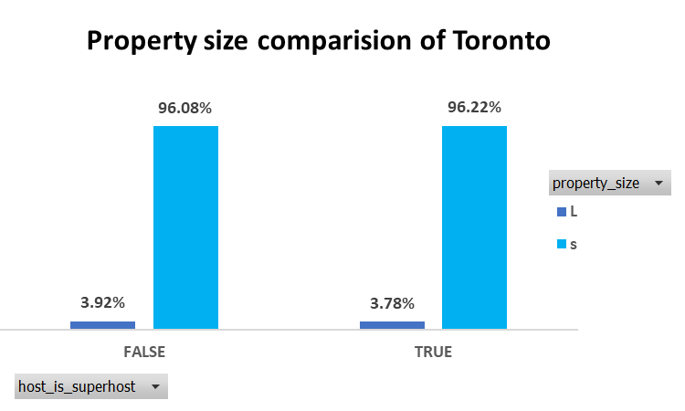
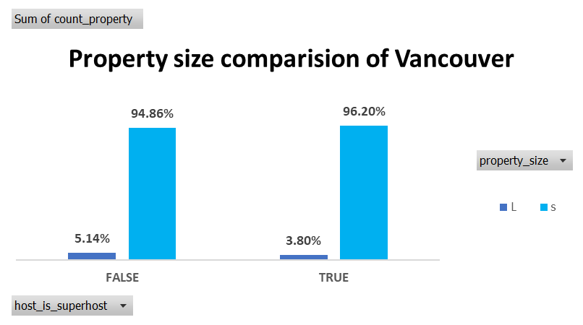
Super Hosts tend to have large property types as compared to Other Hosts
The property which have more than 7 accommodates are considered as large property (L)
The property which have less than or equal 7 accommodates are considered as small property (S)
TORONTO
VANCOUVER
3.92% of host have large property and 3.78% of superhost have large property so we can say that size of property does not play a big role in making superhost
5.14% of host have large property and 3.80% of superhost have large property so we can say that size of property does not play a big role in making superhost

Slide 9
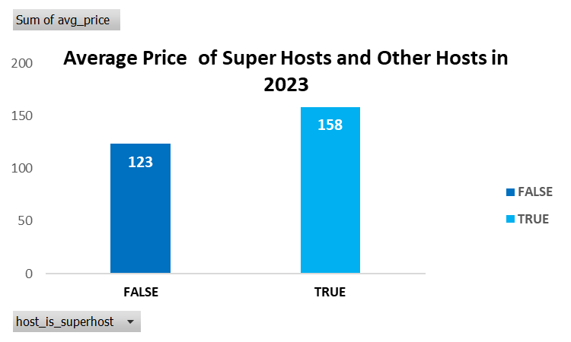
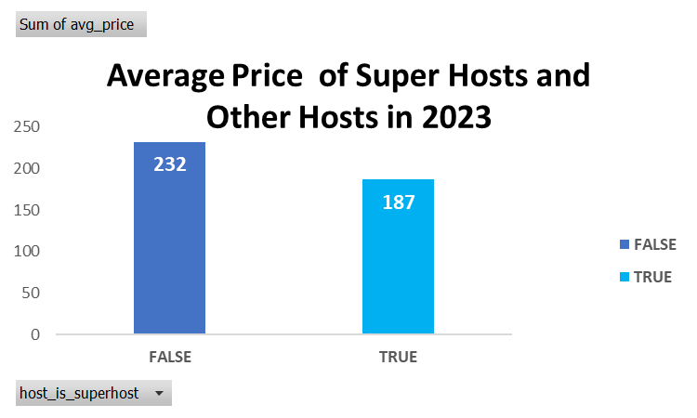
Average price and availability of the listings for the upcoming year between Super Hosts and Other Hosts
TORONTO
VANCOUVER
In Toronto the average price of superhost is higher than that of Host, as we can analyze from the graph
In Vancouver the average price of Host is higher than that of Superhost, as we can analyze from the graph

Slide 10
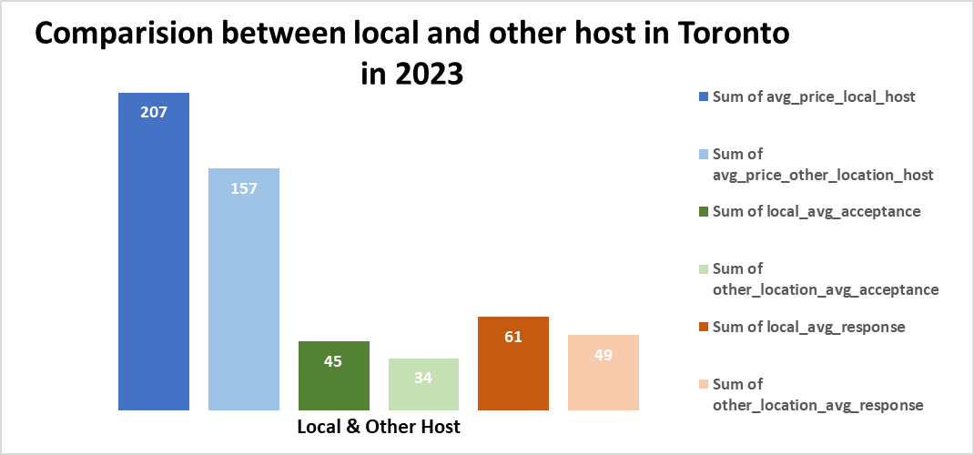
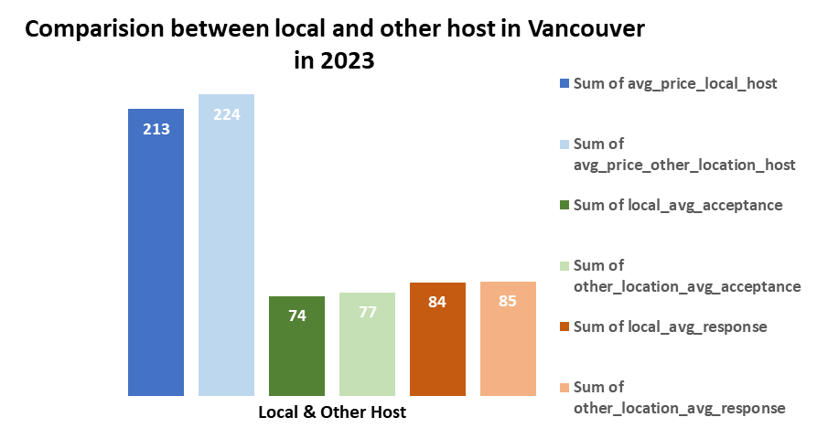
Trends between Local Hosts or Hosts residing in other locations
TORONTO
VANCOUVER
In Toronto in the year 2023, avg_price, avg_acceptance & avg_response
Is higher for LOCAL HOSTS than OTHER LOCATION HOSTS
In Vancouver in the year 2023, avg_price, avg_acceptance & avg_response
Is higher for OTHER LOCATION HOSTS than LOCAL HOSTS
than

Slide 11

Submitted by:-
Aditya Shrivastava(PD_14_225)

